Slide 1
The VM: Program Control
project 6
Yana Gabelev

Slide 2
Links
Project 6:
http://my.jce.ac.il/~arikgi/Web/Ex/Ex06/index.htm
EX06 zip :
http://my.jce.ac.il/~arikgi/Web/Ex/Ex06/Ex06.zip

Slide 3
Program flow
The default execution of computer programs is linear, one command after the other.
VM language features three program flow commands :
label c | This command labels the current location in the function’s code. Only labeled locations can be jumped to from other parts of the program. The scope of the label is the function in which it is defined. The label c is an arbitrary string composed of any sequence of letters, digits, underscore (“_”), dot (“.”), and colon (“:”) that does not begin with a digit.
goto c | This command effects an unconditional goto operation, causing execution to continue from the location marked by the c label. The jump destination must be located in the same function.
if-goto c | This command effects a conditional goto operation. The stack’s topmost value is popped; if the value is not zero, execution continues from the location marked by the c label; otherwise, execution continues from the next command in the program. The jump destination must be located in the same function.

Slide 4
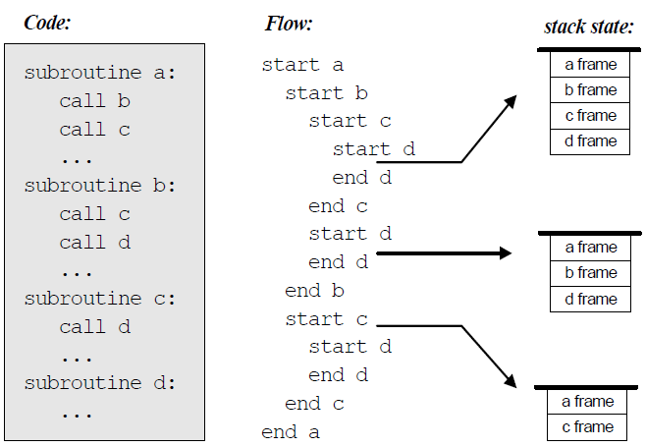
Subroutine Calling
When subroutine xxx calls subroutine yyy, we can push (save) xxx’s world on the stack and branch to execute yyy. When yyy returns, we can pop (reinstate) xxx’s world off the stack, and continue executing xxx as if nothing happened.

Slide 5
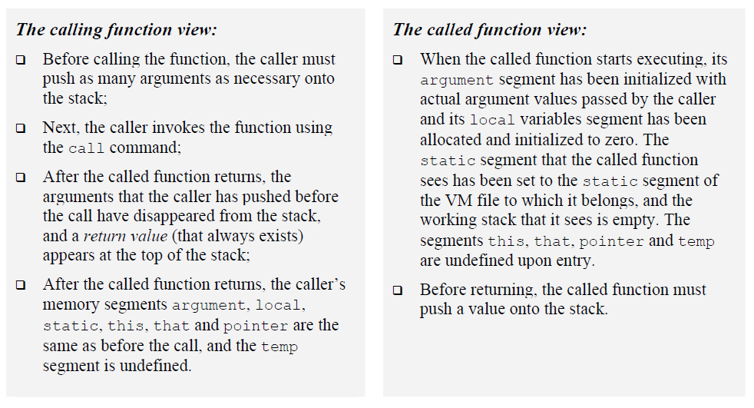
Function Calling Commands
The events of calling a function and returning from a function can be viewed from two different perspectives:

Slide 6
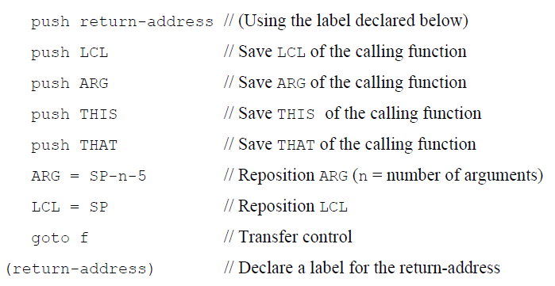
Function Calling Protocol Implementation
Call f m
Call function f stating that m arguments have already been pushed onto the stack by the caller.
Pseudo code:

Slide 7
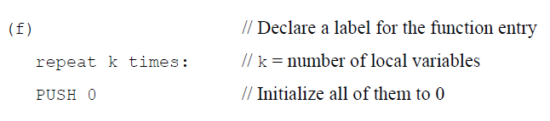
Function Calling Protocol Implementation
function f n
Here starts the code of a function named f, which has n local variables.
Pseudo code:

Slide 8
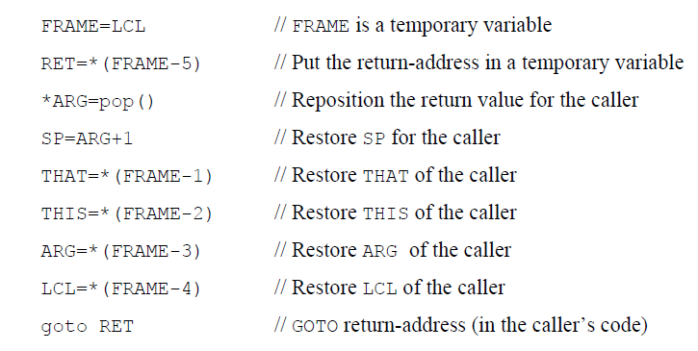
Function Calling Protocol Implementation
return
Return to the calling function.
Pseudo code:

Slide 9
Assembly Language Symbols
Symbol | Usage
SP, LCL, ARG, THIS, THAT | Pre-defined symbols point, to the stack top and to the base addresses of the virtual segments.
R13-R15 | Pre-defined symbols can be used for any purpose.
Xxx.j symbols | Each static variable j in a VM file Xxx.vm is translated into the assembly symbol Xxx.j
functionName$label symbols | Each “label b” command in a VM function f should generate a globally unique symbol “f$b” where “f” is the function name and “b” is the label symbol within the VM function’s code. When translating “goto b” and “if-goto b” VM commands into the target language, the full label specification “f$b” must be used instead of “b”.
functionName labels | Each VM function f should generates a symbol “f” that refers to its entry point in the instruction memory of the target computer.
return-address symbols | Each VM function call should generate and insert into the translated code a unique symbol that serves as a return address.

Slide 10
Bootstrap Code
SP=256 // Initialize the stack pointer to 0x0100
call Sys.init // Start executing (the translated code of) Sys.init
Sys.init is then expected to call the main function of the main program, and enter an infinite loop. This action should cause the translated VM program to start running.

Slide 11
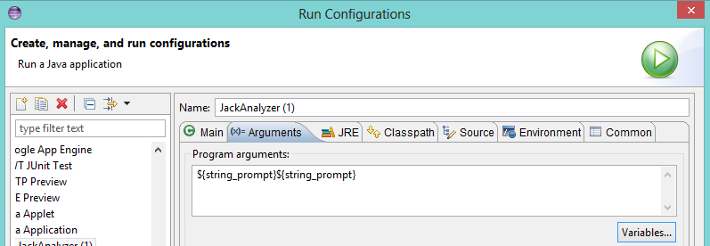
Twist
Add a -noinit flag to your program:
If the traslator is run with this flag the program does not produce init code- This way you can test all the examples.
Your code will get 2 arguments (second is optional):
VMtranslator_folder -noinit
To apply this you have to add another ${string_prompt} in run configuration window.

Slide 12
The Parser Module
If the basic parser that you built in Project 5 does not already parse the six commands specified in this chapter, then add their parsing now.
Specifically, make sure that the commandType method returns the constants corresponding to the six VM commands described in this chapter: C_LABEL;
C_GOTO;
C_IF;
C_FUNCTION;
C_RETURN;
C_CALL.

Slide 13
The CodeWriter Module
Translates VM commands into Hack assembly code. The routines listed below should be added to the CodeWriter of project 5.

Slide 14
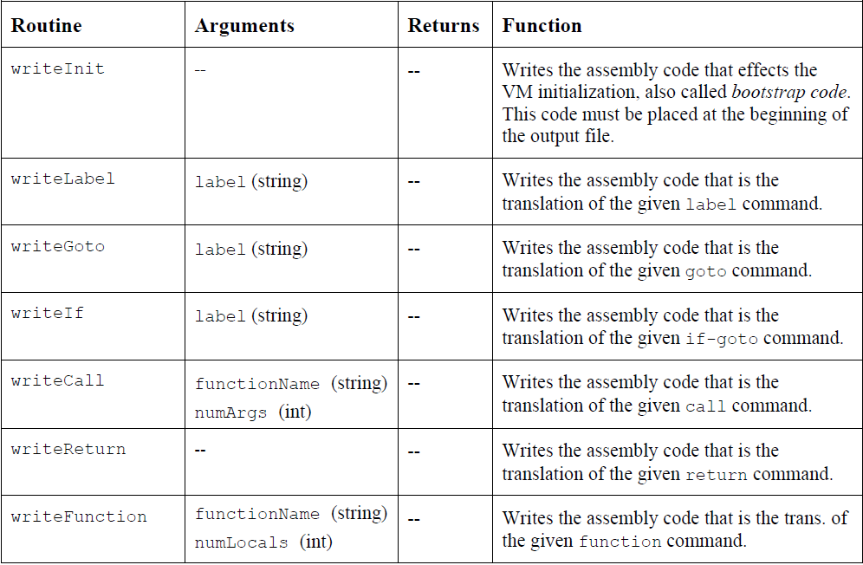

Slide 15
How and what to submit
Create a folder named 2015B_exXX_YYYYYYYY, when XX is the ex number, and YYYYYYYY is your ID.
For example: 2015B_ex06_123456789
All submission files should be in that folder, and no other extra file. Files to submit: source files, README.txt
Zip the folder to a zip file named 2015B_exXX_YYYYYYYY.zip

